Slide 1
CS152 Section 12
Memory Consistency

Slide 2
Agenda
Memory consistency models
Much of this material is taken from: Adve and Gharachorloo. Shared Memory Consistency Models: A Tutorial (1995)
Synchronization
Lab 5 due Monday May 3
PS5 due Monday Apr 26

Slide 3
Memory Consistency: Other half of the ISA
The instruction set and architectural state do not completely define the behavior of the ISA
Sequential ISA only specifies that each processor observes its own memory operations in program order
Need a memory consistency model, which defines the legal set of values that loads can return across multiple hardware threads

Slide 4
Memory Consistency vs Cache Coherence
Coherence describes the legal values that a single memory address could return
Consistency describes properties across all memory address
Coherence alone does not imply any particular memory consistency model!

Slide 5
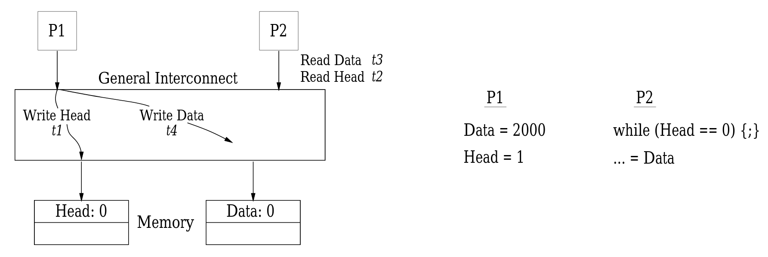
Memory Consistency and Caches
Q: Do memory consistency models apply only to systems with caches?
A: No — consider a cache-less system with multiple memory banks

Slide 6
RISC-V Memory Models
RISC-V currently has two:
Default: Weak memory ordering (RVWMO)
Optional extension: Total store order (RVTSO)

Slide 7
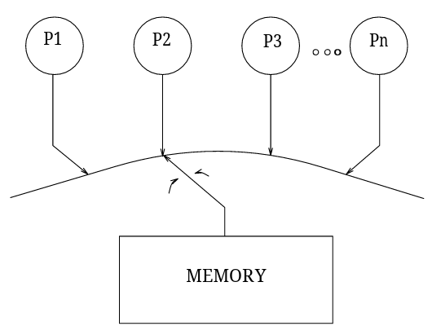
Sequential Consistency: Intuitive Starting Point
Definition: [A multiprocessor system is sequentially consistent if] the result of any execution is the same as if the operations of all the processors were executed in some sequential order, and the operations of each individual processor appear in this sequence in the order specified by its program.
Leslie Lamport. How to Make a Multiprocessor Computer That Correctly Executes Multiprocess Programs (1979)

Slide 8
Worksheet Q1
Consider the following two threads executing on two different cores. Memory locations A, B, and C are initialized to zero.
P1: P2:
li x1, 1 li x1, 2
I1 lw x2, A J1 sw x1, B
I2 sw x1, C J2 lw x2, C I3 lw x3, B J3 sw x1, A
We are interested in the final values of P1.x2, P1.x3, and P2.x2.

Slide 9
Sequential Consistency (Q1.1)
P1: P2:
li x1, 1 li x1, 2
I1 lw x2, A J1 sw x1, B
I2 sw x1, C J2 lw x2, C I3 lw x3, B J3 sw x1, A
Give all possible sets of values of P1.x2, P1.x3, and P2.x2 under sequential consistency.
Operation Order | P1.x2 | P1.x3 | P2.x2

Slide 10
Relaxing Memory Consistency Models
Strictness of SC suggests two major targets for relaxation:
Program order requirement: When can one thread’s memory operations be reordered with respect to one another
Write atomicity requirement: When can a processor see the effect of a write relative to other processors in the system

Slide 11
Relaxing Program Order Requirement
Four types of ordering constraints:
Write → Read
Write → Write
Read → Write
Read → Read
Q: Can you think of a microarchitectural optimization made possible by relaxed ordering?

Slide 12
Relaxing Write Atomicity
Two flavors:
Can a processor see its own write before others?
Can processor A see some other processor B’s writes before they are made visible to the rest of the memory system?
Q: Can you think of a microarchitectural optimization that would make (1) true? What about (2)?

Slide 13
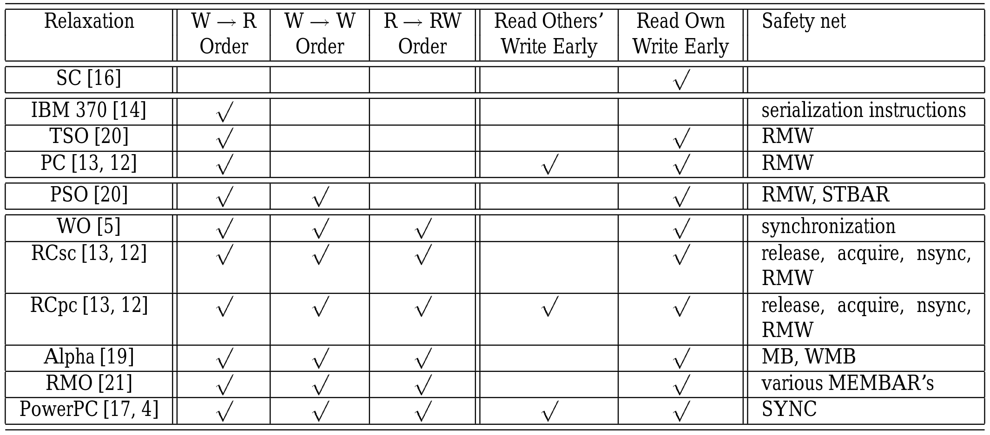
Categorizing Relaxed Models

Slide 14
W→R Relaxation (Q1.2)
P1: P2:
li x1, 1 li x1, 2
I1 lw x2, A J1 sw x1, B
I2 sw x1, C J2 lw x2, C I3 lw x3, B J3 sw x1, A
Give all new possible sets of values if we relax Write → Read ordering and the instruction orderings that caused them.
Operation Order | P1.x2 | P1.x3 | P2.x2

Slide 15
W→W Relaxation (Q1.3)
P1: P2:
li x1, 1 li x1, 2
I1 lw x2, A J1 sw x1, B
I2 sw x1, C J2 lw x2, C I3 lw x3, B J3 sw x1, A
Give all new possible sets of values if we relax Write → Write ordering and the instruction orderings that caused them.
Operation Order | P1.x2 | P1.x3 | P2.x2

Slide 16
R→R and R→W Relaxation (Q1.4)
P1: P2:
li x1, 1 li x1, 2
I1 lw x2, A J1 sw x1, B
I2 sw x1, C J2 lw x2, C I3 lw x3, B J3 sw x1, A
Give all new possible sets of values if we relax Read → Read and Read → Write ordering constraints and the instruction orderings that caused them.
Operation Order | P1.x2 | P1.x3 | P2.x2

Slide 17
Using Fences to Constrain Memory Ordering
The RISC-V FENCE instruction comes in several fine-grained variants:
Write → Read FENCE w,r
Write → Write FENCE w,w
Read → Write FENCE r,w
Read → Read FENCE r,r
Can combine constraints: FENCE r,rw == FENCE r,r; FENCE r,w FENCE without parameters is a full barrier: FENCE rw,rw

Slide 18
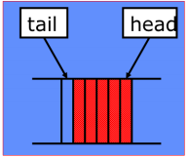
Producer-Consumer Synchronization (Q2)
A producer thread computes some value and sends it to a consumer thread through a queue.
The queue is an array in memory with a head pointer and a tail pointer.
The producer pushes an item onto the queue by writing to the address pointed to by the tail pointer and then incrementing the tail.
The consumer pulls an item from the queue by reading from the address pointed to by the head pointer and then incrementing the head.
Producer | Consumer
# x1: address of tail pointer # x2: data to be written ld x3, 0(x1) sd x2, 0(x3) addi x3, x3, 8 sd x3, 0(x1) | # x1: address of tail pointer # x2: address of head pointer ld x3, 0(x2) spin: ld x4, 0(x1) beq x3, x4, spin ld x5, 0(x3) addi x3, x3, 8 sd x3, 0(x2) # then process x5

Slide 19
Producer | Consumer
# x1: address of tail pointer # x2: data to be written ld x3, 0(x1) sd x2, 0(x3) addi x3, x3, 8 sd x3, 0(x1) | # x1: address of tail pointer # x2: address of head pointer ld x3, 0(x2) spin: ld x4, 0(x1) beq x3, x4, spin ld x5, 0(x3) addi x3, x3, 8 sd x3, 0(x2) # then process x5
Would this code still behave correctly under a relaxed memory model?

Slide 20
Producer | Consumer
# x1: address of tail pointer # x2: data to be written ld x3, 0(x1) sd x2, 0(x3) addi x3, x3, 8 sd x3, 0(x1) | # x1: address of tail pointer # x2: address of head pointer ld x3, 0(x2) spin: ld x4, 0(x1) beq x3, x4, spin ld x5, 0(x3) addi x3, x3, 8 sd x3, 0(x2) # then process x5
What is the minimum set of fence instructions that needs to be added to make these programs work under a relaxed memory model?

Slide 21
Now assume we have multiple producers sharing the same queue.
Rewrite the producer code to make it thread safe.
Assume we no longer have to worry about the order of storing to the queue vs. storing the tail pointer. (Many producers, no consumer)
# x1: address of tail pointer
# x2: data to be written
enqueue_using_amoadd:
Atomic Fetch-and-Add
amoadd rd, rs1, (rs2)
rd <= M[rs2] M[rs2] <= rd + rs1

Slide 22
Now assume we have multiple producers sharing the same queue.
Rewrite the producer code to make it thread safe.
Assume we no longer have to worry about the order of storing to the queue vs. storing the tail pointer. (Many producers, no consumer)
# x1: address of tail pointer
# x2: data to be written
enqueue_using_cas:
Compare and Swap
cas rd, rs1, rs2, (rs3)
if (rs1 == M[rs3]) M[rs3] <= rs2 rd <= 1 else rd <= 0

Slide 23
Now assume we have multiple producers sharing the same queue.
Rewrite the producer code to make it thread safe.
Assume we no longer have to worry about the order of storing to the queue vs. storing the tail pointer. (Many producers, no consumer)
# x1: address of tail pointer
# x2: data to be written
# x3: address of lock variable
enqueue_using_ts:
Test and Set
ts rd, (rs)
rd <= M[rs] M[rs] <= 1

